Slide 1
Safety Training
Molecular Materials Research Center
Beckman Institute
California Institute of Technology

Slide 2
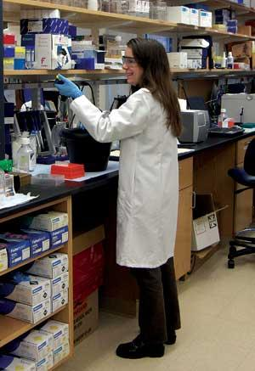
MMRC Chemical laboratory Clothing Policy
Long pants, and shirts that cover upper torso and upper arms are required.
  Safety glasses, lab coats, and gloves must be worn at all times in chemical laboratories.
  Gloves should not be used to open doors, or type on computers.
  No Food or Drinks Allowed in Any Laboratories.

Slide 3
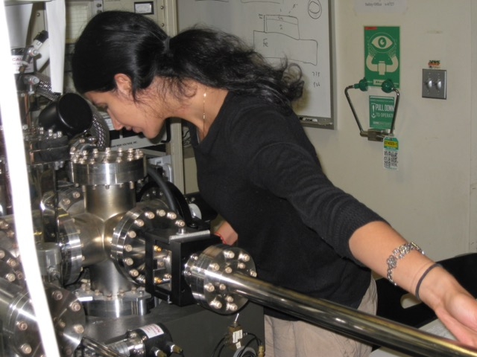
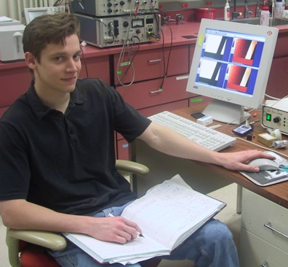
MMRC Instrument laboratory Policy
  Always sign up for an instrument before use.
  Long pants, shirt that covers upper torso and upper arms, and close toe shoes are required in instrument laboratories.
  Gloves should be worn when handling any samples or high vacuum equipment.
  Safety glasses, lab coats, and gloves require when working with chemicals.
  No Food or Drinks Allowed in Any Laboratories.

Slide 4
Samples and Chemicals
Label all chemicals brought into MMRC Labs: your name, date, and sample name.
Remove all samples and chemicals when you are finished with the experiment.
Do not
  leave chemicals or samples for disposal by others.
  open bottles or use beakers if you are not the owner.
  do any chemical experiments in the labs unless authorized.

Slide 5

Safety Information Resources
Caltech Environment, Health, and Safety
  Chemical Hygiene Plan
  Hydrofluoric Acid Work Procedures
  Hazardous Waste Disposal Procedures
  Emergency Response Guide
    All Available On-Line

Slide 6

Safety Information Resources
Chemical Safety Manual
  Available On-Line at
    http://www.cce.caltech.edu/resources/Safety.pdf

Slide 7
Responding to Incidents
Remember all MMRC laboratories are chemical labs and have hazardous chemicals on benches and in hoods. Only touch your own materials.

Slide 8
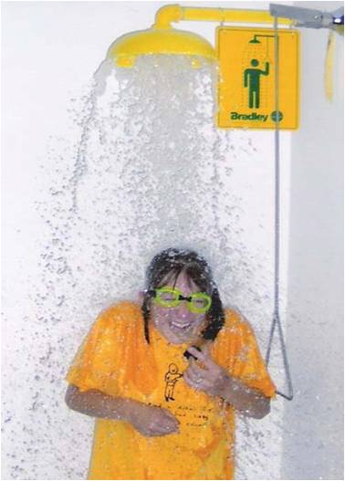
Chemical Exposure
  Call 5000
  or 626 395 5000
Use the Nearest Emergency Shower or Eyewash
  15 Minutes or Until the Paramedics Arrive
Going to the Emergency Room or Occupational Health?
  Take a Material Safety Data Sheet (MSDS) with You

Slide 9
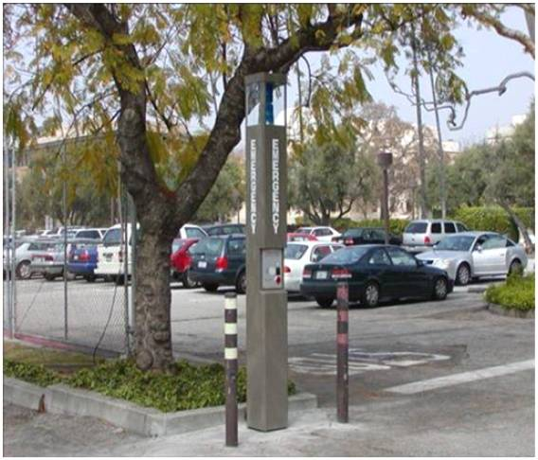
Emergency Contact Numbers
Call x 5000 for Campus Emergencies
Cell Phone
  (626) 395-5000
Emergency Kiosks
  Hit the Button

Slide 10
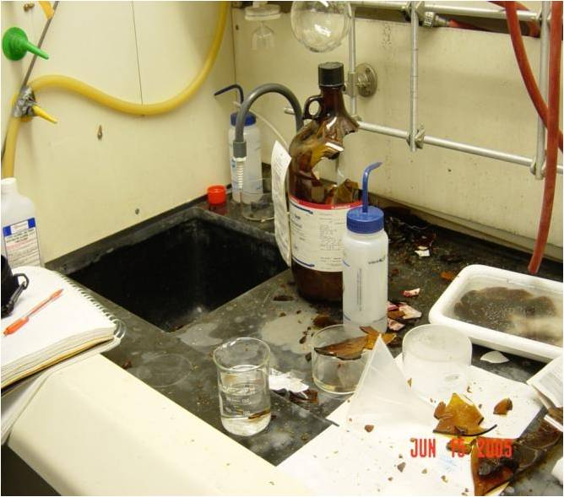
Chemical Spill
Chemical Spill
  Alert People in Area
  Small Spill
    Self-Clean
    Call Safety @ 6727
  Large Spill
    Contain
    Call Security @ 5000
      Provide Information

Slide 11
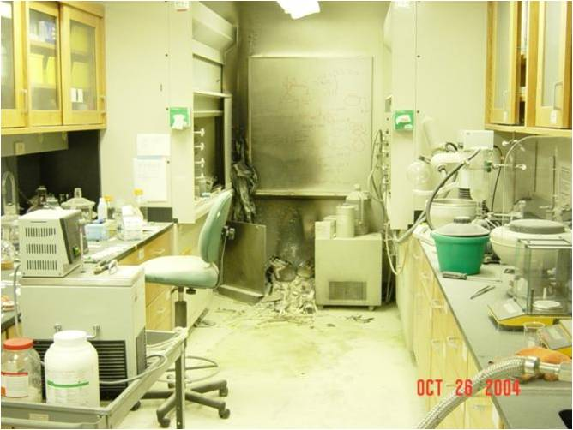
Fire
Alert People in Area
  Yell “Fire”
Small
  Use ABC Fire Extinguisher
Large
  Evacuate the Area
    Evacuation Assembly Area
Call x5000 Provide Information

Slide 12
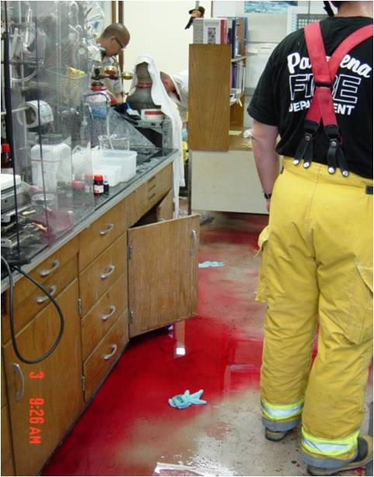
Injuries
  Call 5000
  Keep Calm
  Provide Information
    Don’t Make Assumptions

Slide 13
Liquid Cryogens
Liquid Nitrogen (LN2)
Liquid Helium

Slide 14
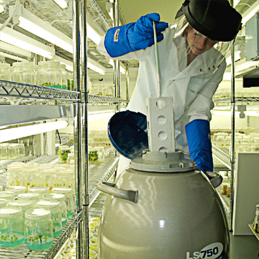
Working w/ Cryogenic Liquids
(Liquid Nitrogen or Helium)
Personal Protective Equipment
  Safety Glasses w/ Side Shields – Full Face Shield for open transfers
  Loose Fitting Thermal Gloves
  Long Sleeved Shirt and Pants
  Closed Toed Shoes
    Must be Worn When Pouring or Filling

Slide 15
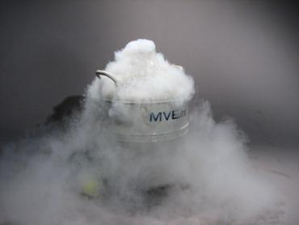
Working w/ Liquid Cryogens
Safe Handling
  Use in Well Ventilated Areas
  Use an Appropriate Dewar
    Keep capped but not sealed When Not in Use
  Use Gloves or Tongs to Handle Frozen Objects
    Do Not Submerge Gloves in LN₂

Slide 16
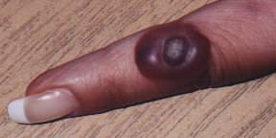
Hazards of Liquid Cryogens
Extremely Low Temperature
  Splashing Liquid Can Cause “Burns”
    Frost Bite
  Materials May Become Brittle and Break

Slide 17
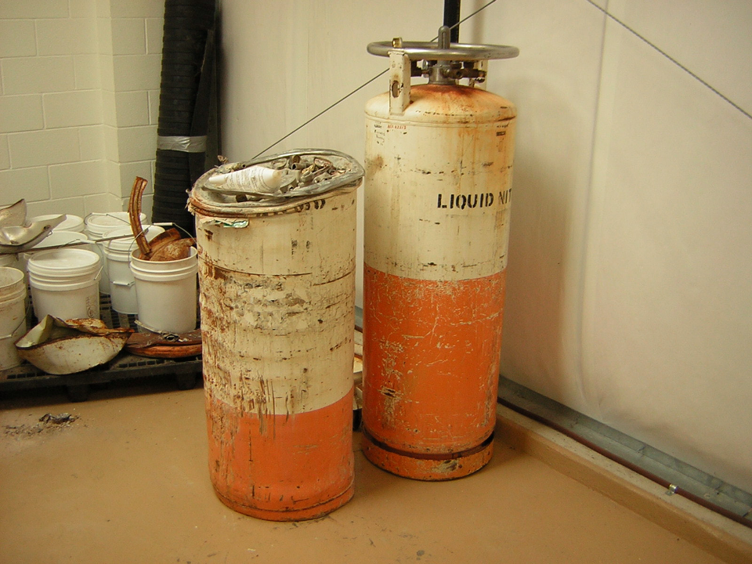
Hazards of Liquid Cryogens
Liquid to Gas Expansion Ratio: 1 to ~700
  Build Up of Pressure
  Possible Explosion
    Like a Rocket
  Displacement of O₂ in Confined Spaces

Slide 18
Compressed Gases
High Pressure Gas Tanks

Slide 19
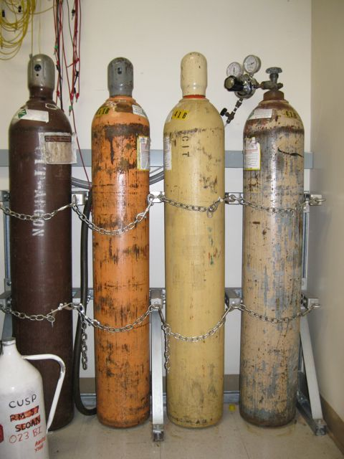
Securing Gas Cylinders
All Cylinders Must be Stored and Secured in a Approved Gas Cylinder Rack
  Double Chained
    Top and Bottom

Slide 20
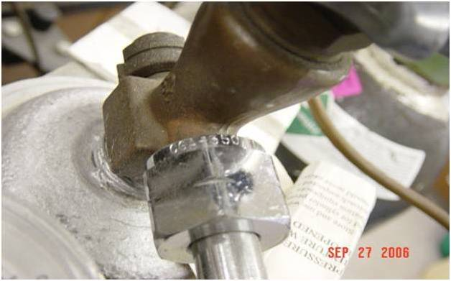
Regulators
Make Sure That the Regulator has the Proper CGA Connection for the Valve Outlet
  The Regulator CGA # Must Match the Gas Cylinder CGA #
Do Not Over Tighten the Regulator When Attaching it to the Gas Cylinder Outlet

Slide 21
Hazardous Waste Disposal
All chemicals and samples should be taken with you when you leave the MMRC laboratory. Only authorized users are allowed to dispose of or store chemicals in MMRC laboratories.

Slide 22
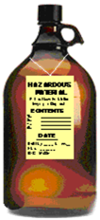
Waste Determination
  Material vs. Waste
    No Intended Use or Reuse
    Don’t Want it
    Don’t Need It
      Call it Waste

Slide 23
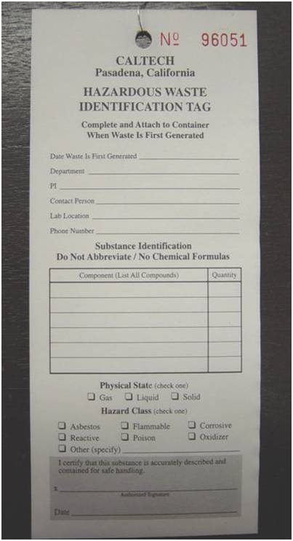
Hazardous Waste Tag
  “Waste”
    Must Have a Tag
  Each Container
    Individual Waste Tag
      Attached and Dated
        First Drop
      Hazard Class / Physical State
      List Quantities or Percentages
      No Formulas or Abbreviations

Slide 24
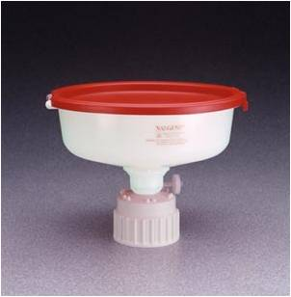
Waste Containers
  Closed at All Times
    Except When Adding Waste
      No Evaporation or Drain Disposal Allowed
  Use Spill Trays
    Secondary Containment

Slide 25
Remember
Label all chemicals brought into MMRC Labs with your name, date, and sample name.
Remove all chemicals and samples when finished.
Only work in lab areas where you were trained.
Only work on instruments after you are trained.
Do not touch chemicals that do not belong to you.
If you need help contact a GLA
For safety incident call x5000 from lab phone.
Report instrument problems in logbook and to a GLA and Bruce Brunschwig (bsb@caltech.edu)

